Slide 1
Revenue and Expense Analysis of Nonprofit Organizations in Texas
LI Wenkang*, YE Li, HAN Xiao, XU Meiying

Slide 2
Research Design

Slide 3
Research Questions
Do nonprofits rely less on external resources to be financially solid?
Have nonprofits succeeded in cutting their administrative costs?
Which sectors attract most financial resources?
Do different types of nonprofits adopt different financing strategies?

Slide 4
Datasets

Slide 5
Information That We Extracted
1, Amazon S3: 2015-2019
990: https://www.irs.gov/pub/irs-pdf/f990.pdf
990EZ: https://www.irs.gov/pub/irs-pdf/f990ez.pdf
990PF: https://www.irs.gov/pub/irs-pdf/f990pf.pdf
2, NCCS: Business Master Files(BMF) 2015-2019:
EINs, Organization names, Year, Mission sectors, Total income

Slide 6
Collecting and Processing Data

Slide 7
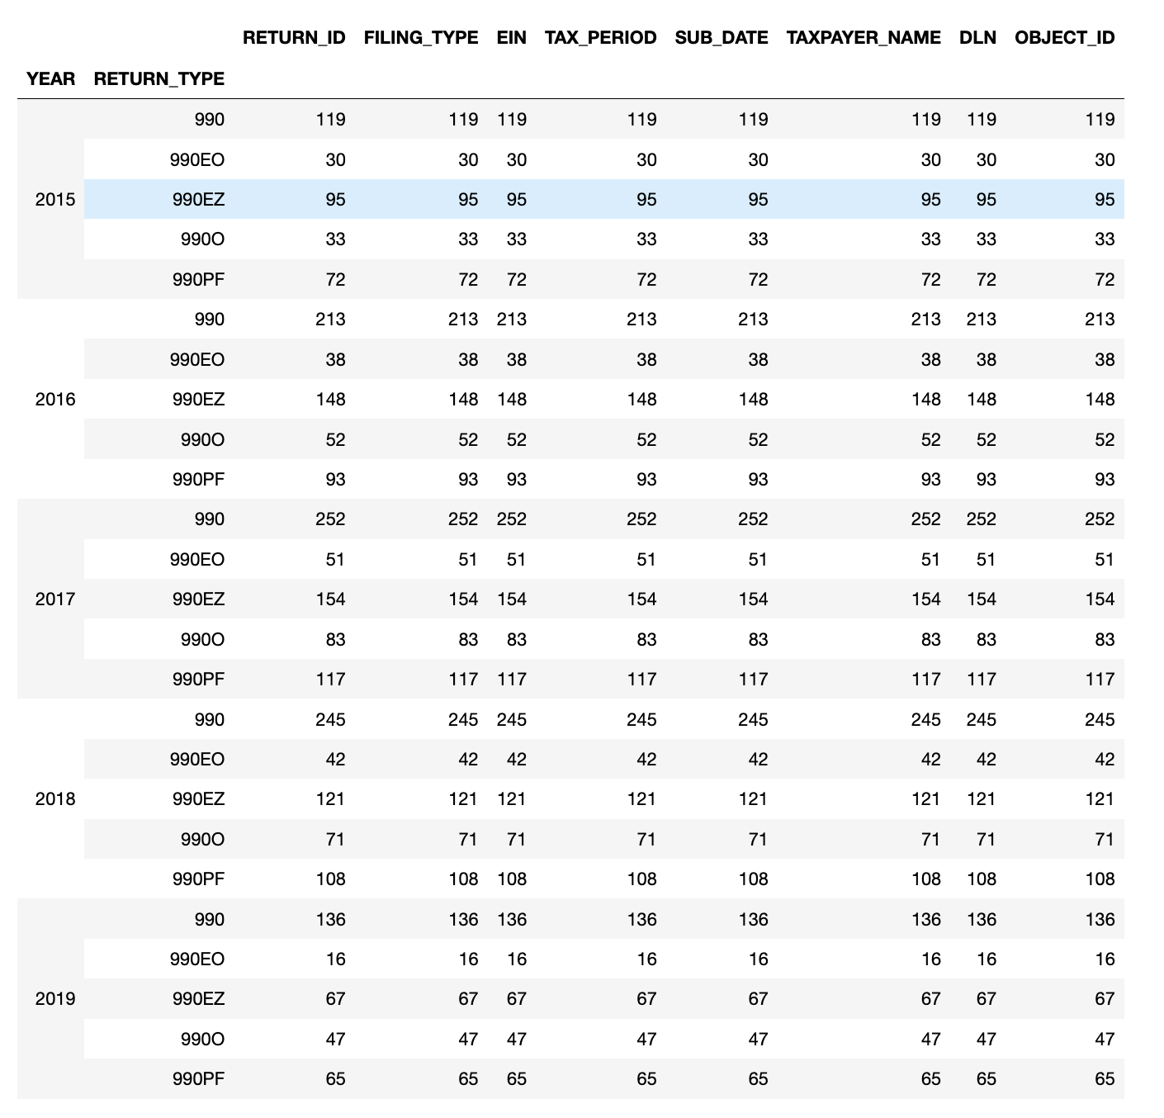
Result from Amazon S3
Variable References:
http://www.irsx.info/
https://drive.google.com/drive/folders/1DJIlzc1joViDw_ky2_7LQNFCS-fAOxY7?ths=true

Slide 8
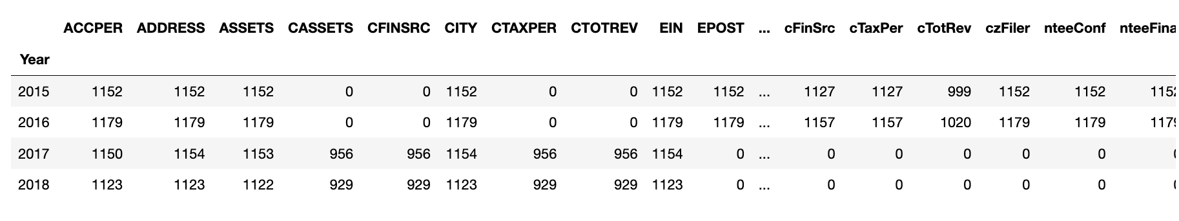
Result from NCCS

Slide 9
Results

Slide 10
Which sectors attract the most financial resources?

Slide 11
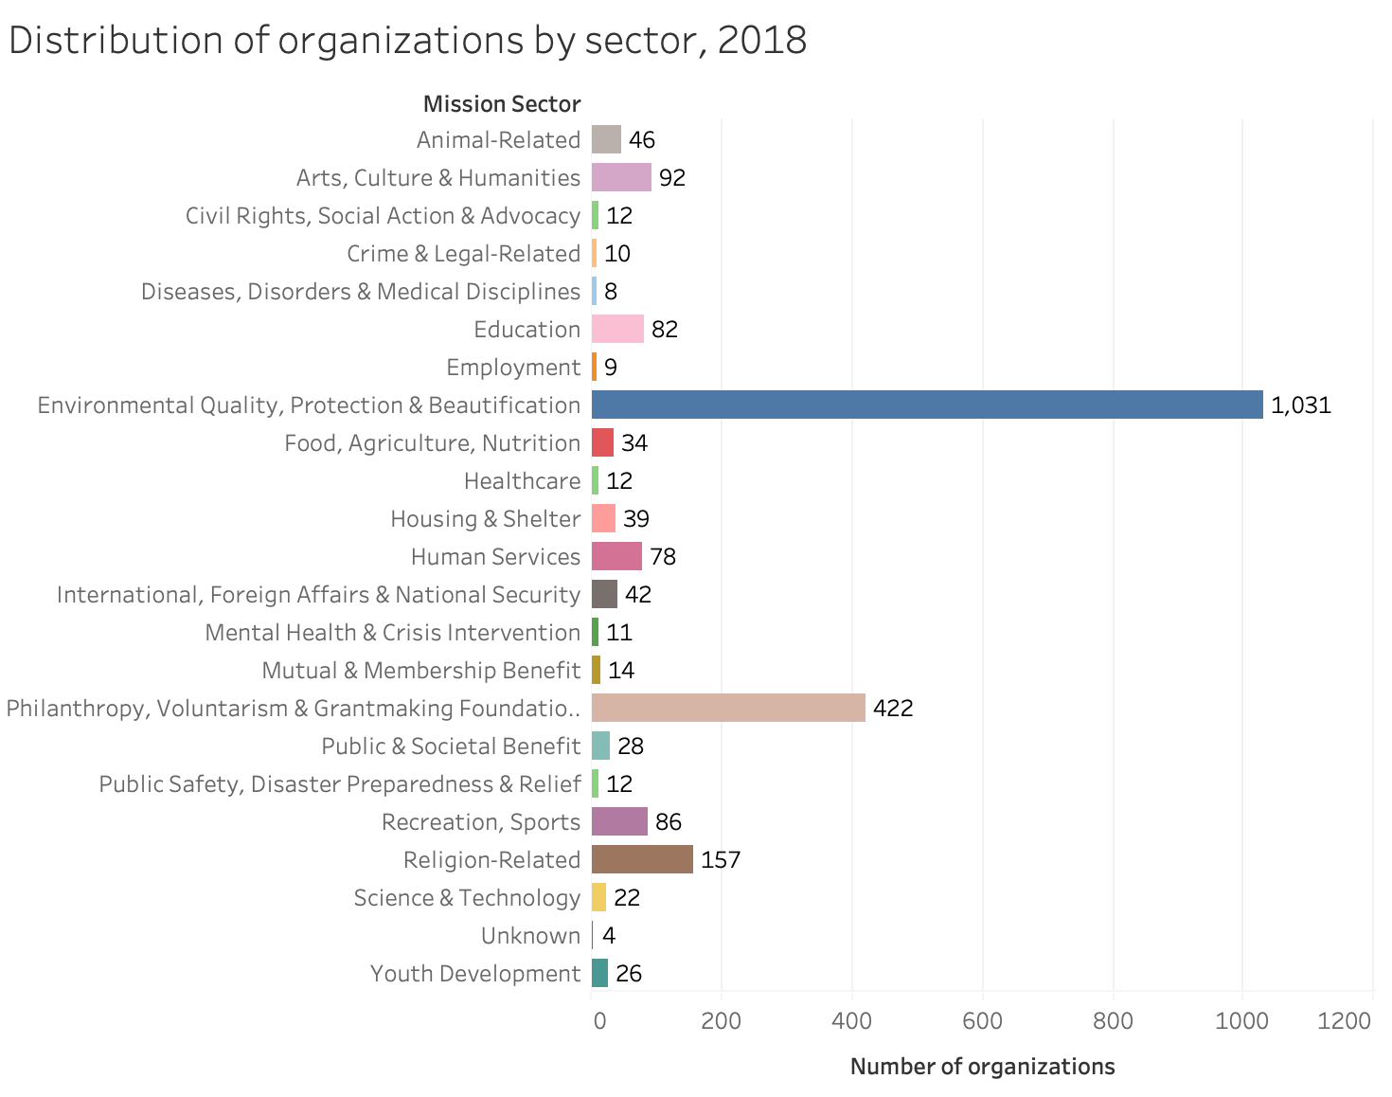

Slide 12
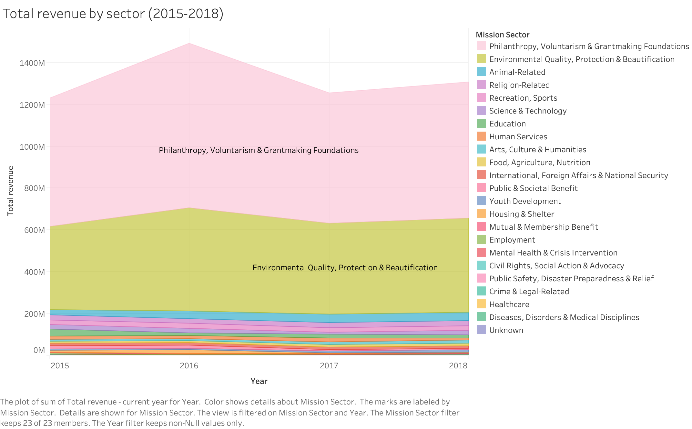

Slide 13
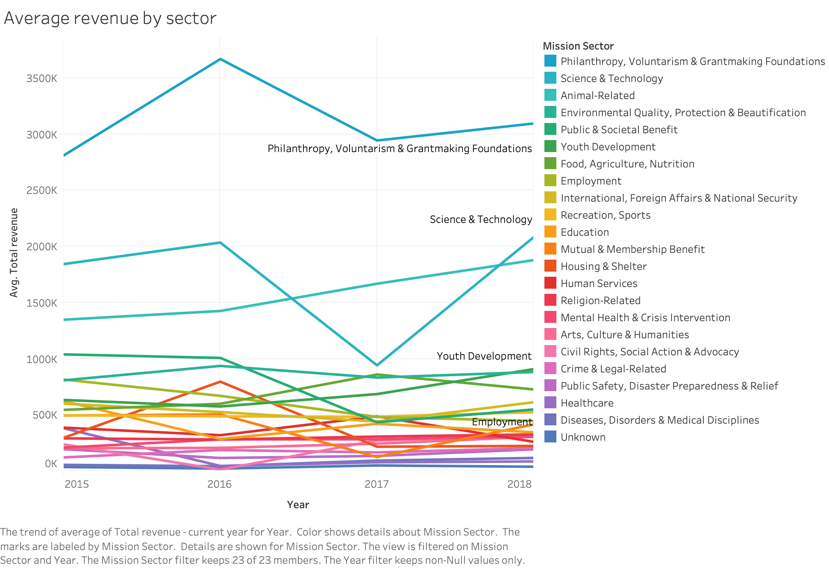

Slide 14
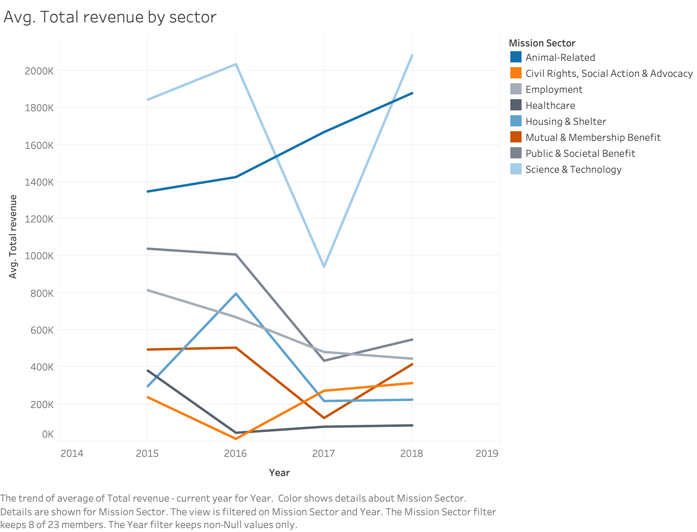
Science & Tech
animal related

Slide 15
Do nonprofits rely less on external resources to be financially solid?

Slide 16
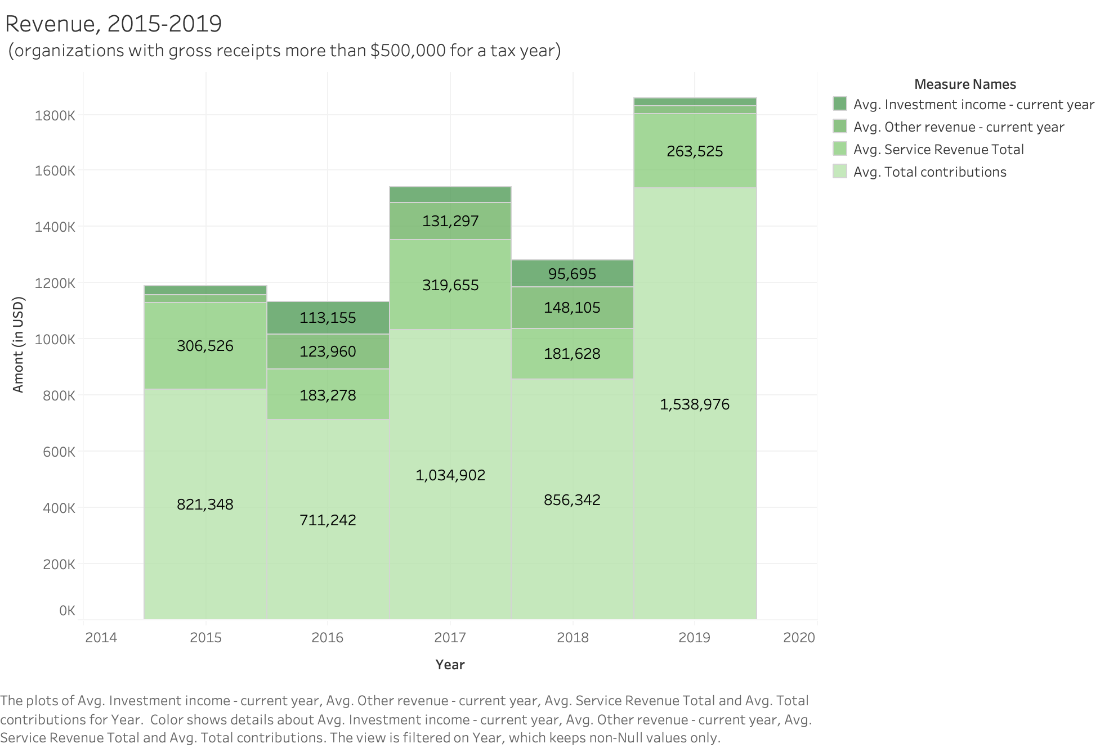

Slide 17
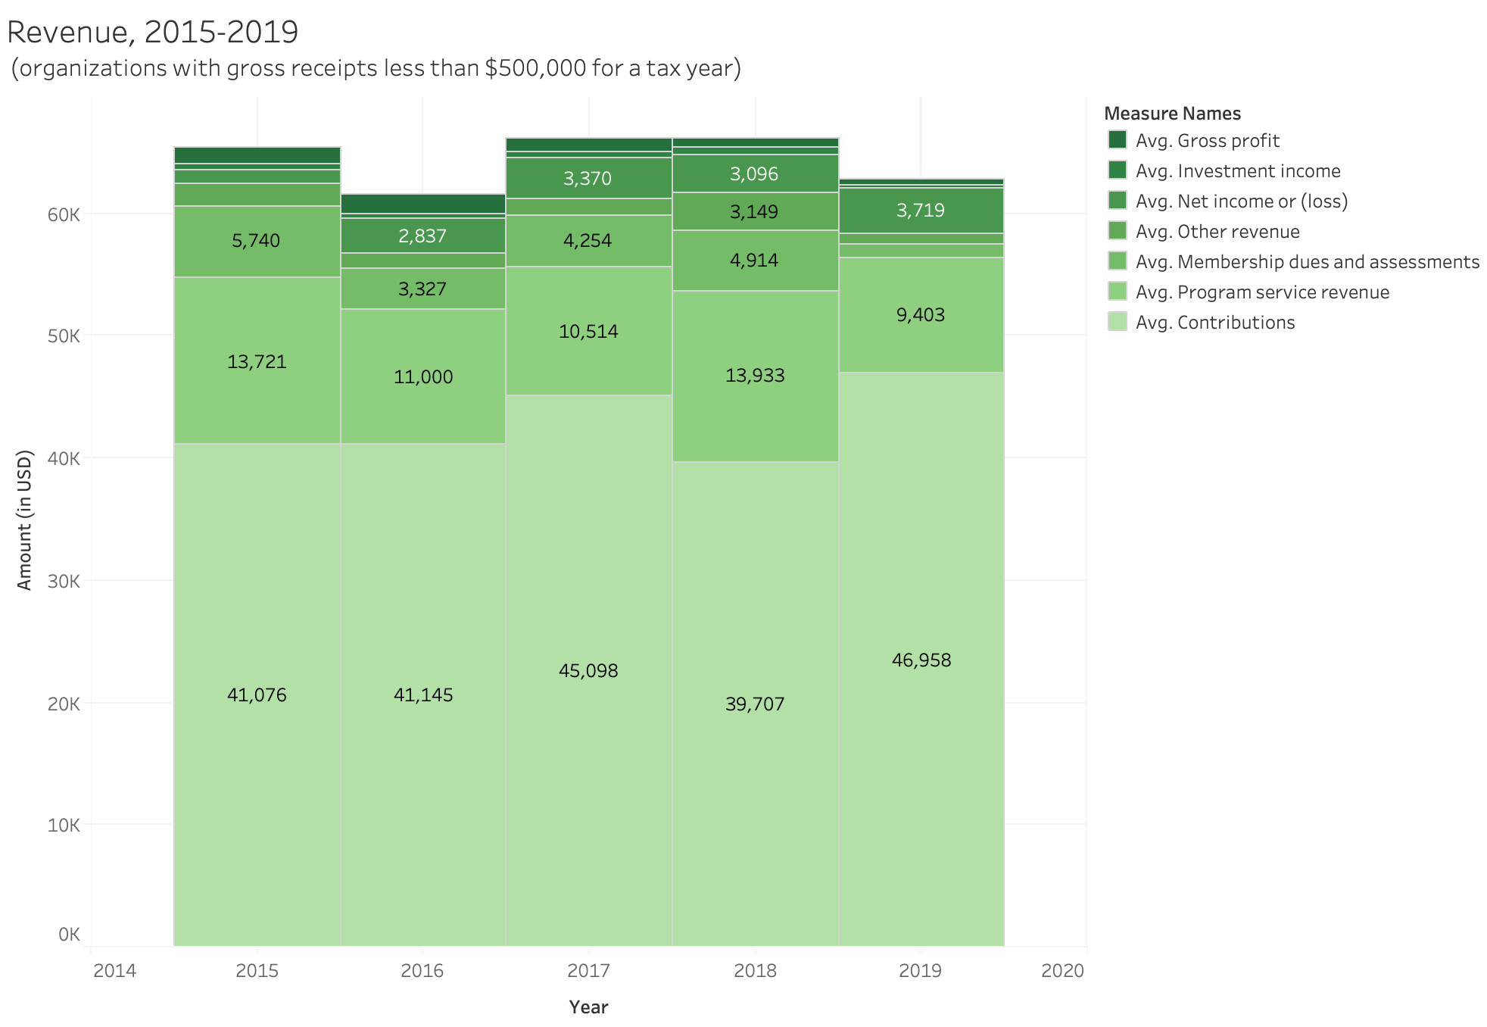

Slide 18
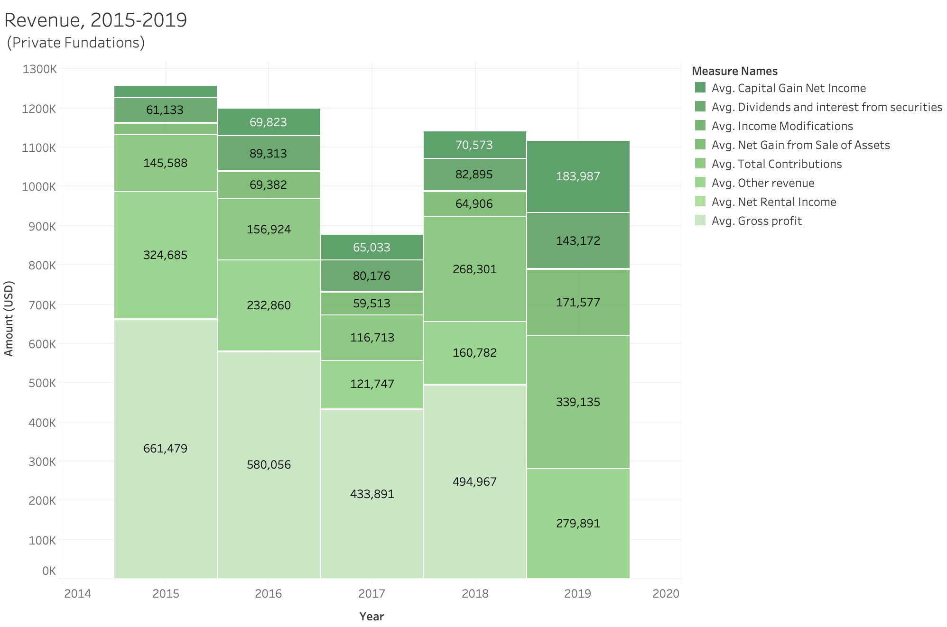

Slide 19
Have nonprofits succeeded in cutting their administrative costs?

Slide 20
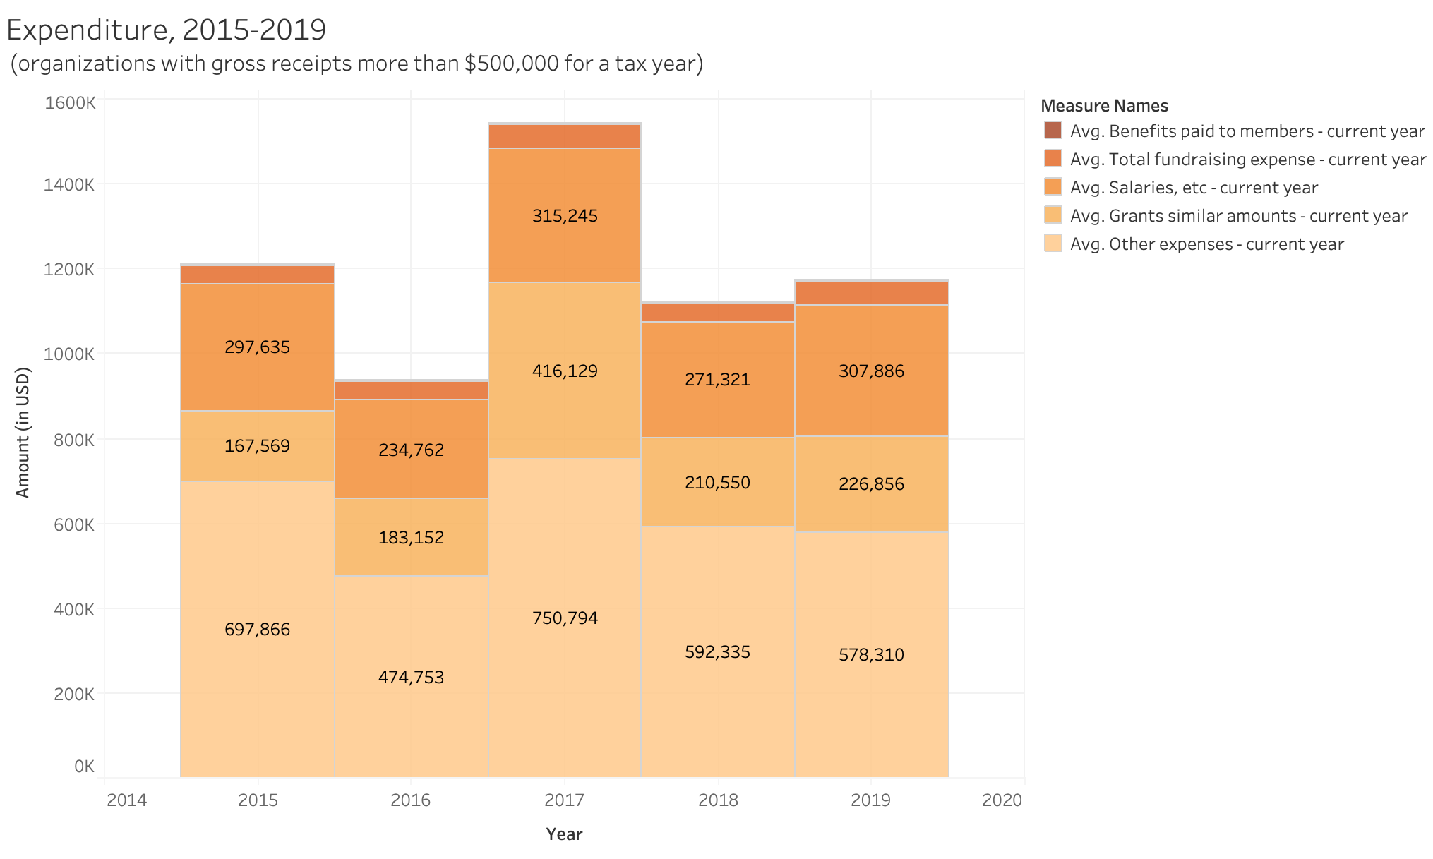

Slide 21
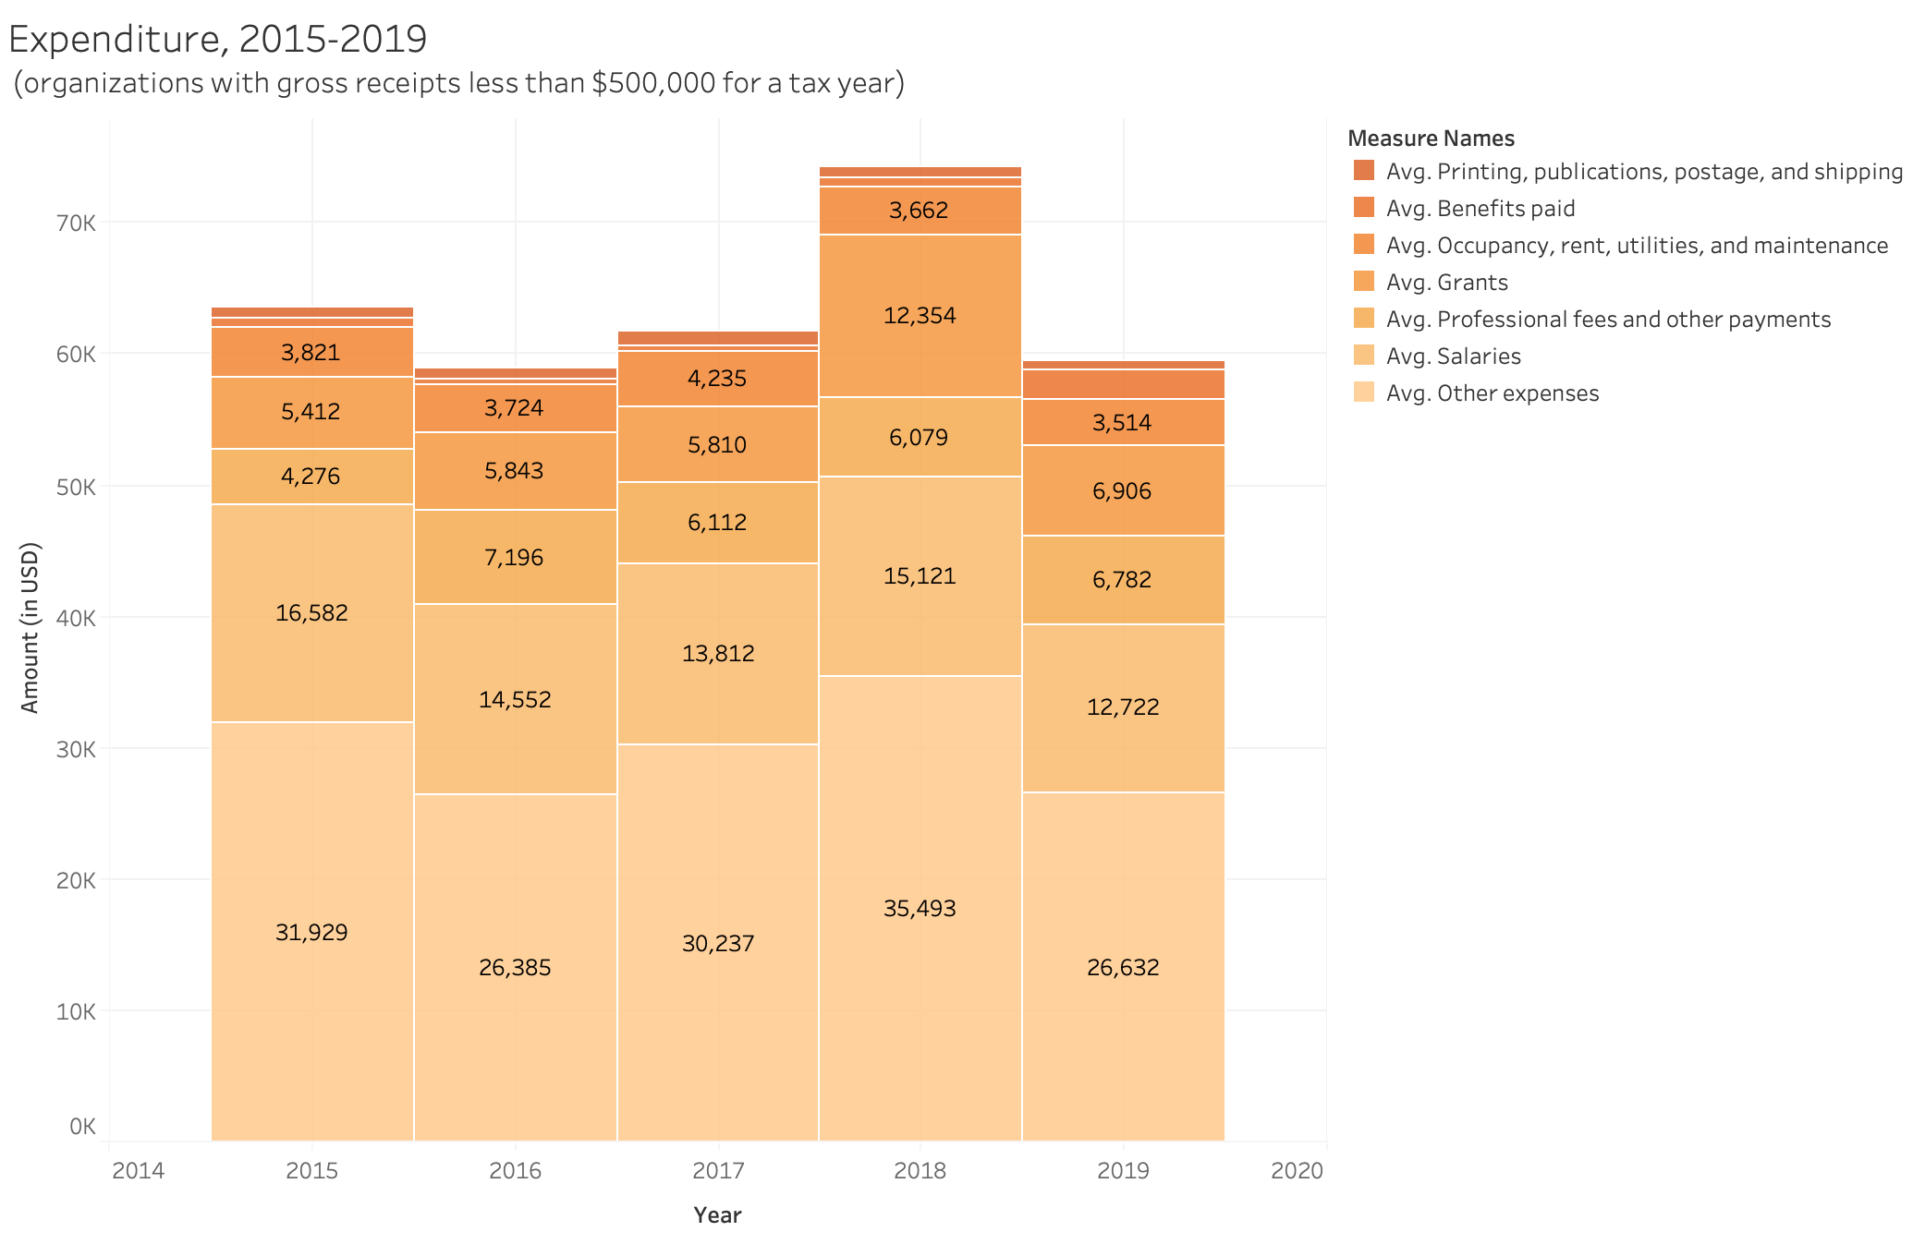

Slide 22
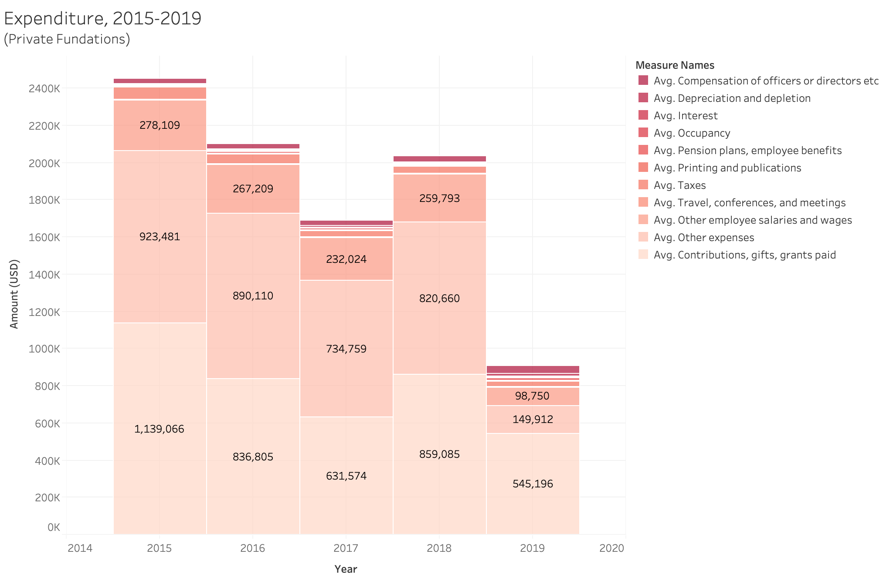

Slide 23
Do different types of nonprofits adopt different financing strategies?

Slide 24
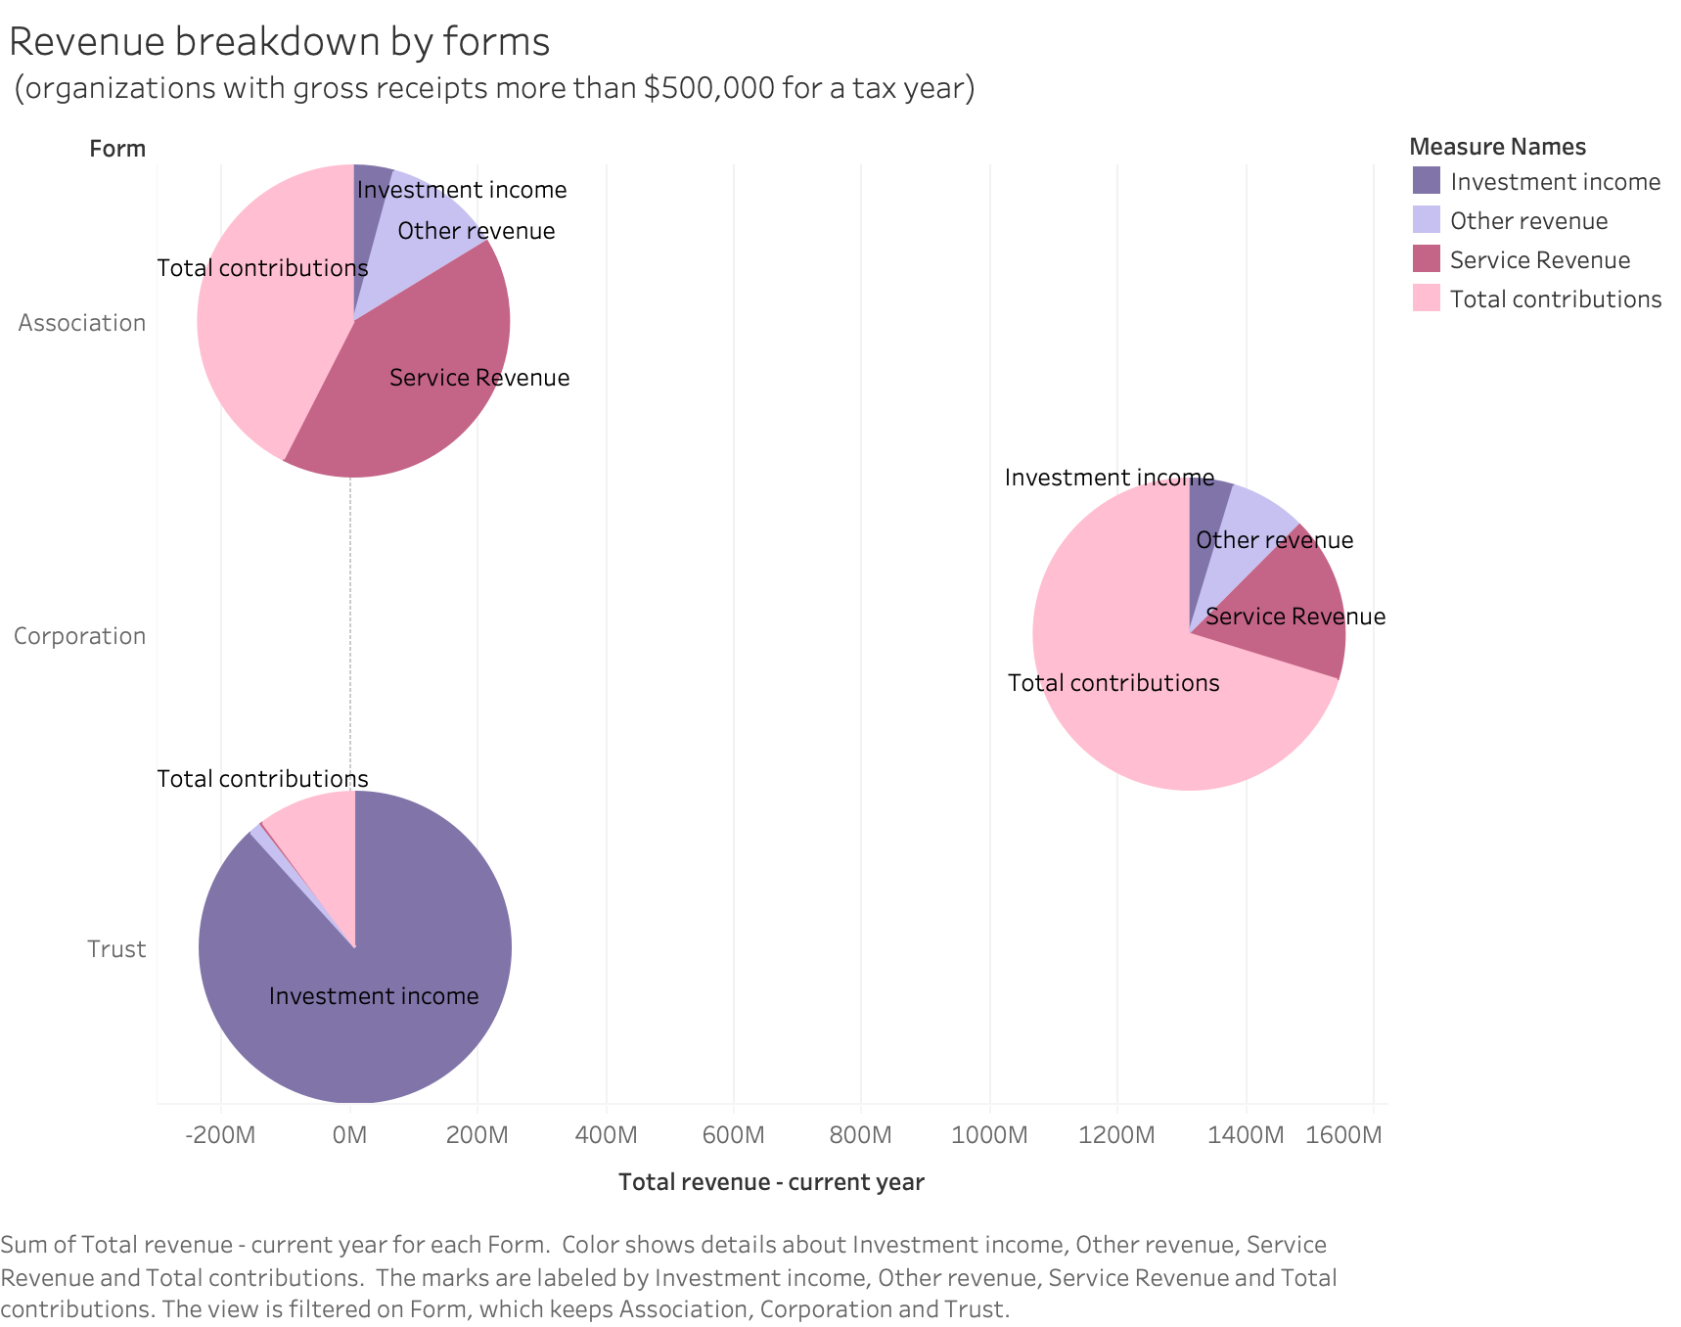

Slide 25
Future research

Slide 26
Unanswered questions
Why such inequality in access to capital across mission sectors exists?
Is there a causal relationship between the main source of revenue and the mission of an organization? Or broadly speaking, do nonprofits receiving more funding from the government are more government-oriented?
How to improve nonprofit management and cut managerial costs?
What explains the revenue jump in 2017?

